Slide 1
A Novel Vision Transformer Based Deep Learning Model to Predict Chronic Kidney Disease
Project Member Details:
ASUTOSH TRIPATHY
MANDELA SATISH
SUDHANSHU DAS
Project Guide:
Dr. T. RAJALAKSHMI
ASSOCIATE PROFESSOR, DEPT OF ECE, SRMIST

Slide 2
Index
Index | Page.No
Introduction | 3
Objective of the Project | 4
Problem Statement | 5
Literature review | 6
Novelty | 10
Design | 12
Results | 14
Engineering standards | 21
Realistic Constraints | 22
Software and Hardware utilized | 23
References | 24

Slide 3
Introduction
Chronic Kidney Disease (CKD) is a progressive condition where the kidneys lose their ability to filter waste and fluids, impacting around 753 million people globally and causing 1.2 million deaths as of 2017.
CKD is classified into three main types: cysts, tumors, and stones. Each type presents differently and requires specific diagnostic and treatment approaches.
Kidney cysts are fluid-filled sacs usually harmless; kidney tumors are abnormal cell growths that can be benign or malignant; and kidney stones are solid crystalline formations caused by the accumulation of substances like minerals, acids, and salts.

Slide 4
Objective of the work
To develop a highly accurate CKD prediction model that compares the performance of machine learning and deep learning methods to identify the most effective approach.

Slide 5
Problem Statement
This project utilizes Machine Learning (ML) and Deep Learning (DL) techniques that offer a powerful solution to predict CKD at early stages, improving patient outcomes.
These techniques could provide clinicians with accurate, data-driven insights that support effective decision-making.

Slide 6
Literature Review
S.No | TITLE | AUTHOR | JOURNAL | INFERENCE
1. | Artificial intelligence in nephrology: detecting chronic kidney disease using neural network | Hridoy, Md. Farhan Rakib Asif, Ahnaf Mahmud, Mashruf Rahman, Rashad Siraj, Md Sahin | Journal of Brac University, Institutional Repository, 2024 | It evaluated several pre-trained models, including VGG16, ResNet50, and EfficientNetB0, to assess the model's effectiveness in CKD diagnosis and classification with a final validation accuracy of 91.79%
2. | A Biomedical Dataset Analysis on Predictive Modeling of Chronic Kidney Disease Using Machine Learning | G. Jeyalakshmi, F. Vincy Lloyd, K. Subbulakshmi, G. Vinudevi | Optimizing Intelligent Systems for Cross-Industry Application, 2024 | The study proposes a Random Forest-based system for early CKD detection, achieving 94% accuracy and surpassing traditional methods. However, its effectiveness may be limited by the need for large, high-quality training datasets, which aren't always available in clinical settings.

Slide 7
Literature Review
S.No | TITLE | AUTHOR | JOURNAL | INFERENCE
3. | Prediction of metabolic syndrome and its associated risk factors in patients with chronic kidney disease using machine learning techniques | Jalila Andréa Sampaio Bittencourt, Carlos Magno Sousa Junior | Brazilian Journal of Nephrology, 2024 | Out of 196 adults evaluated, 12.24% had CKD, and 45.8% of them also had MS. The KNN algorithm achieved 79% accuracy and sensitivity, with 80% specificity (AUC = 0.79) for MS screening.
4. | Early detection of chronic kidney disease using data mining methods | Suresh Babu Satukumati, M. Nirupama Bhat | International Journal of Advanced Intelligence Paradigms Vol. 28, No. 1-2, 2024 | This study uses a fuzzy neural algorithm to predict CKD with 84% accuracy. However, its complexity in training and interpretation, especially with large datasets, is a major limitation.

Slide 8
Literature Review
S.No | TITLE | AUTHOR | JOURNAL | INFERENCE
5. | Predictive Modelling of Chronic Kidney Disease Using Gaussian Naive Bayes Algorithm | Muthia Febriana Azizah, Arimbi Tiara Paramitha | International Journal of Artificial Intelligence in Medical Issues, Vol.2 No.2, 2024 | This study applies Gaussian Naive Bayes for CKD prediction with 89.93% accuracy. A key drawback is its assumption of feature independence, which can reduce accuracy when features are correlated.
6. | On the diagnosis of chronic kidney disease using a machine learning-based interface with explainable artificial intelligence | Gangani Dharmarathne , Madhusha Bogahawaththa , Marion McAfee , Upaka Rathnayake , D.P.P. Meddage | Intelligent Systems with Applications Volume 22, June 2024 | This study uses XGB with SHAP and PDP for explainable CKD prediction, achieving 92.3% accuracy. However, SHAP and PDP can be slow, may oversimplify interactions, and face challenges in complex models.

Slide 9
Literature Review
S.No | TITLE | AUTHOR | JOURNAL | INFERENCE
7. | Prediction of Chronic Kidney Disease Using Machine Learning Classification Techniques and ANN | S. Vidhya, S. Balachandar | Disruptive Technologies for Sustainable Development, 1st Edition, 2024 | The work done focuses on using machine learning techniques, specifically Support Vector Machines (SVM) and Decision Trees, to predict the presence and severity of Chronic Kidney Disease (CKD) based on a dataset containing 400 patient records with 14 attributes they achieved an accuracy of 91.5%

Slide 10
Novelty
Utilized the hierarchical and global attention mechanisms of MaxViT (Multi-axial Vision Transformer) to capture intricate spatial features in kidney CT scan images.
Enhanced model performance through meticulous hyperparameter tuning for improved feature extraction and learning.
Achieved more precise classification outcomes compared to conventional CNN and transformer-based models.

Slide 11
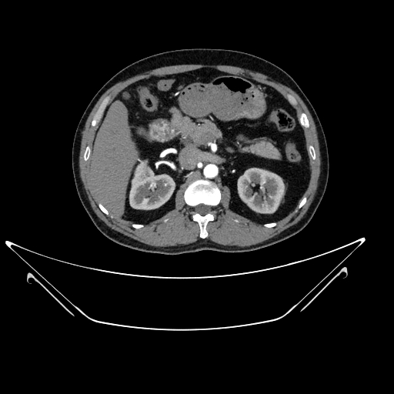
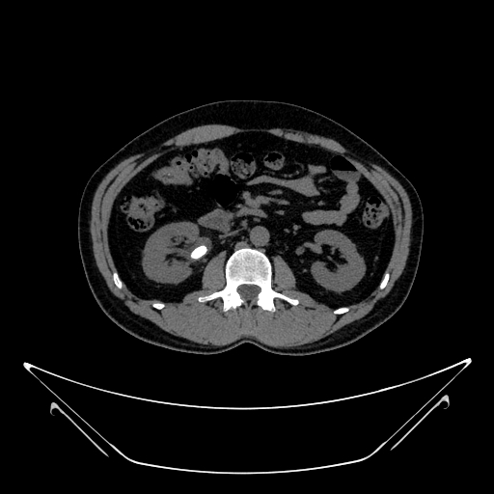
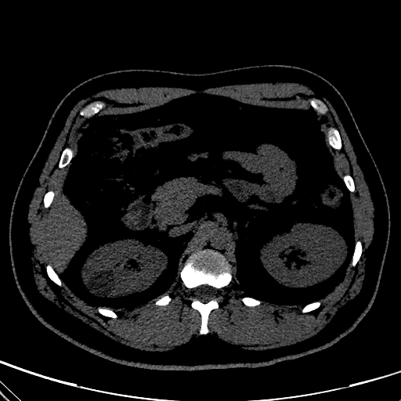
Block Diagram
Data Augmentation
Data Pre-Processing
Data Acquisition
CT- Kidney
Dataset
(12,446)
Image resizing
Applying median filter
Rotation
Vertical flip
Shear
Contrast
Reflection
Model Evaluation
Classification
Validation
Evaluating the performance:
Sensitivity
Precision
Accuracy
F1-score
AUC In ROC curve
Resnet
Resnet with Random forest
Vision Transformer
80% Training
10% Testing
10% Validation
Augmented data

Slide 12
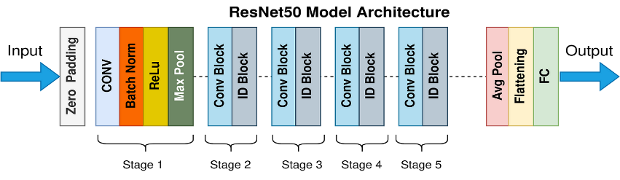
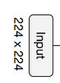
Design of ResNet50
Normal
Cyst
Tumor
Stone
Fig 1. Architecture of Resnet50

Slide 13
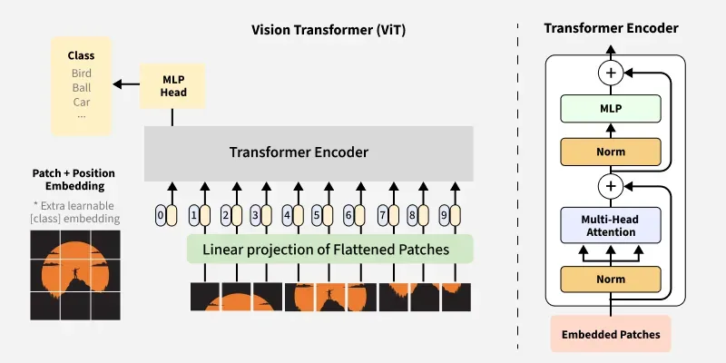
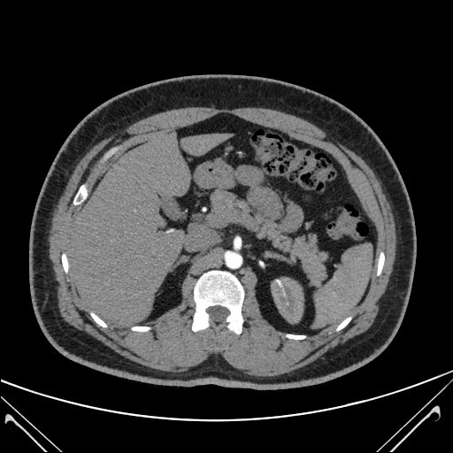
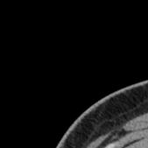
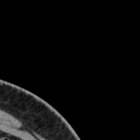
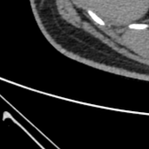
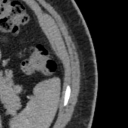
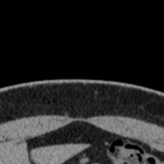
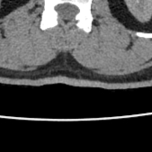
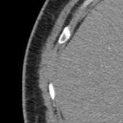
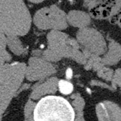
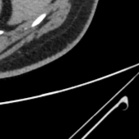
Design of Vision Transformer
Normal
Cyst
Tumor
Stone
Fig 2. Architecture of Vision Transformer

Slide 14
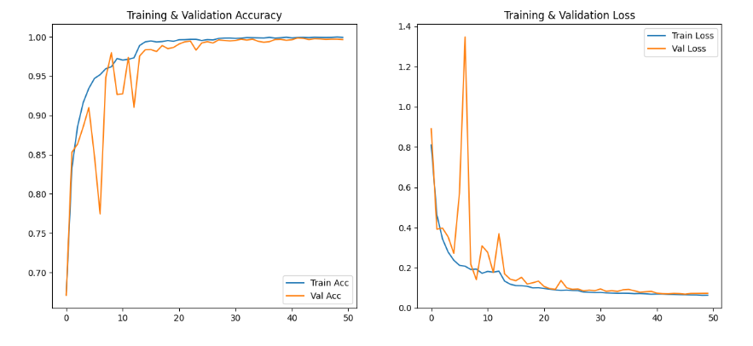
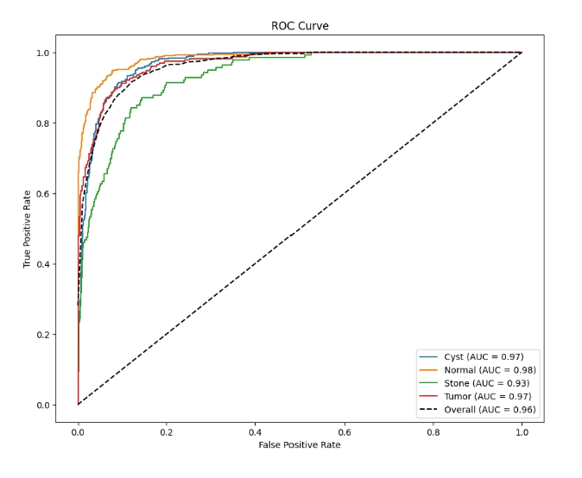
Results for Resnet
Resnet : This ResNet model achieved moderate training and test accuracy, Despite its balanced precision, recall, and F1 score, the model exhibited misclassifications.
AUC=0.96
Fig 3. Loss and Accuracy Graphs for ResNet Fig 4. ROC curve for Resnet

Slide 15
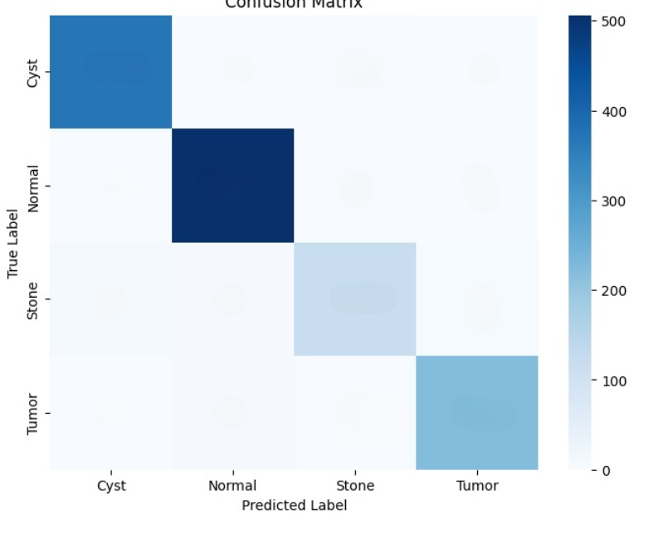
Confusion matrix for Resnet
331
3
35
3
16
472
16
5
46
9
82
2
33
45
6
145
Fig 5. Confusion matrix for Classification using Resnet

Slide 16
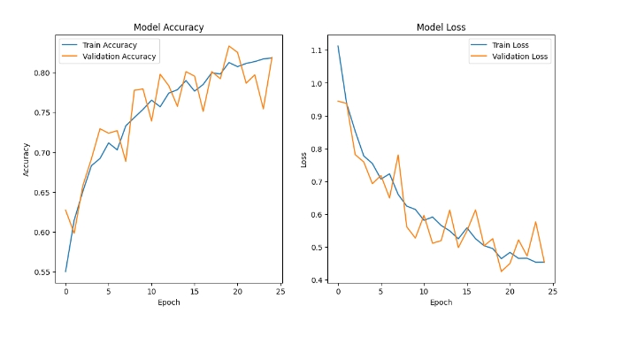
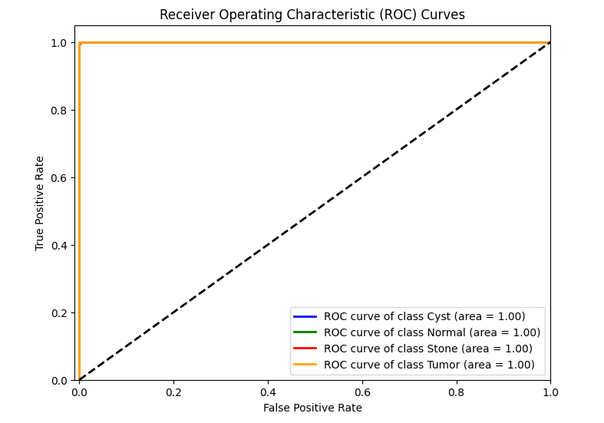
Results for Resnet with random forest
Resnet with random forest : Combining ResNet with Random Forest significantly improved detection performance.
AUC: 0.99
Fig 6. Loss and Accuracy Graph of Resnet with Random forest Fig 7. ROC curve for Resnet with Random Forest m

Slide 17
Confusion matrix for Resnet with random forest
336
3
1
2
2
505
1
1
5
1
132
1
1
4
2
223
Fig 8. Confusion matrix for Classification using Resnet with Random Forest

Slide 18
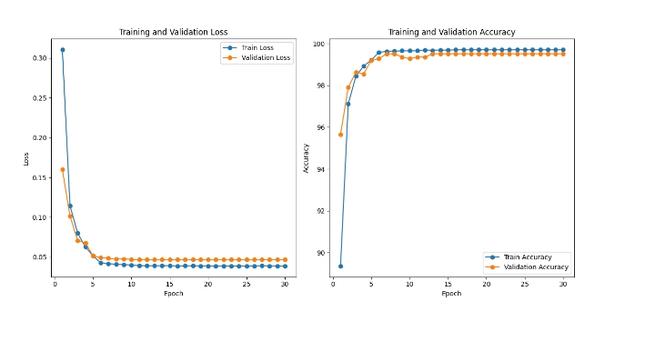
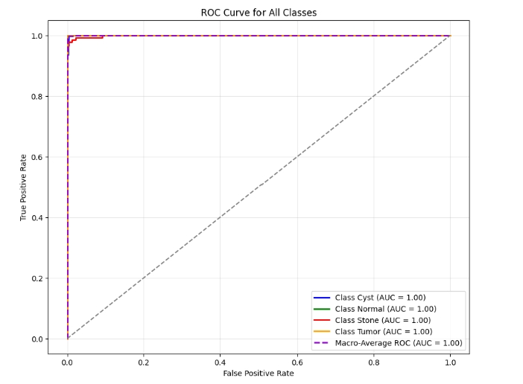
Results for Vision transformer
Vision Transformer : This model achieved good accuracy, indicating its ability to accurately detect kidney disease with minimal misclassification. AUC=0.9982
Fig 9. Loss and Accuracy Graph of Vision Transformer Fig 10. ROC curve for Vision Transformer

Slide 19
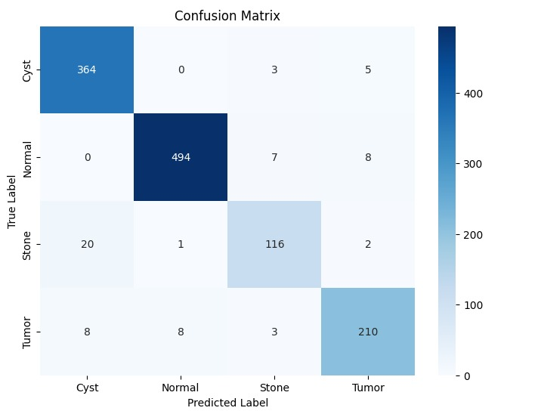
Confusion matrix for Vision transformer
509
0
0
0
0
372
0
0
6
2
131
0
0
1
0
228
Fig 11. Confusion matrix for Classification using Vision Transformer

Slide 20
Results Comparision
Table 1. Comparision between different models
Metrics
 | Accuracy | Precision | Recall | F1 score
Resnet50 | 83.18% | 0.821 | 0.823 | 0.82
Resnet with Random forest | 97.75% | 0.971 | 0.968 | 0.9695
Vision transformer | 99.28% | 0.9928 | 0.9929 | 0.9927
Models

Slide 21
Engineering Standards
IEEE 12207 - Software Lifecycle Processes
ISO 14971 - Risk Management for Medical Devices
HIPAA (Health Insurance Portability and Accountability Act)
IEEE 1878 - Health Informatics - Digital Imaging and Communication in Medicine (DICOM)
pep8- Python Enhancement proposal 8
Good Clinical Practice (GCP) Standards

Slide 22
Realistic Constraints
Deep learning models require significant computational power, especially for training.
Models risk overfitting on the training data if not properly regularized or if the dataset lacks diversity
Even a minor error in code, forgetting to import a particular library, wrong implementation of a function would need us to redo the whole training process again

Slide 23
Software/Hardware Required
Deep learning frameworks like TensorFlow and PyTorch, Programming language is Python
Data handling and processing tools like NumPy and Pandas for numerical and data manipulation in Python and OpenCV for computer vision tasks
IDE( Integrated Development Environments) for coding and managing projects
Matplotlib and Seaborn libraries and Tensor Board for creating plots and visualizations. GitHub for hosting repositories and collaboration
High performance hardware with robust CPU and at least 16GB RAM

Slide 24
References
[1] Hridoy, M. F. R., Asif, A., Mahmud, M., Rahman, R., & Siraj, M. S. (2024). Artificial intelligence in nephrology: detecting chronic kidney disease using neural network (Doctoral dissertation, Brac University).
[2] Jeyalakshmi, G., Lloyd, F. V., Subbulakshmi, K., & Vinudevi, G. (2024). A Biomedical Dataset Analysis on Predictive Modeling of Chronic Kidney Disease Using Machine Learning. In Optimizing Intelligent Systems for Cross-Industry Application (pp. 175-196). IGI Global..
[3] Bittencourt, J. A. S., Sousa, C. M., Santana, E. E. C., Moraes, Y. A. C. D., Carneiro, E. C. R. D. L., Fontes, A. J. C., ... & Nascimento, M. D. D. S. B. (2024). Prediction of metabolic syndrome and its associated risk factors in patients with chronic kidney disease using machine learning techniques. Brazilian Journal of Nephrology, 46(4), e20230135.
[4] Satukumati, S. B., & Bhat, M. N. (2024). Early detection of chronic kidney disease using data mining methods. International Journal of Advanced Intelligence Paradigms, 28(1-2), 86-99.
[5] Azizah, M. F., & Paramitha, A. T. (2024). Predictive modelling of chronic kidney disease using gaussian naive bayes algorithm. International Journal of Artificial Intelligence in Medical Issues, 2(2), 125-135..
[6] Dharmarathne, G., Bogahawaththa, M., McAfee, M., Rathnayake, U., & Meddage, D. P. P. (2024). On the diagnosis of chronic kidney disease using a machine learning-based interface with explainable artificial intelligence. Intelligent Systems with Applications, 200397..
[7] Liu, S., Liu, S., Cai, W., Pujol, S., Kikinis, R., & Feng, D. (2014, April). Early diagnosis of Alzheimer's disease with deep learning. In 2014 IEEE 11th international symposium on biomedical imaging (ISBI) (pp. 1015-1018). IEEE.

Slide 25
THANK YOU

